Slide 1
Introduction to AWS Cloud Computing

Slide 2
Understanding Cloud Computing Concepts

Slide 3
Benefits of Using AWS Cloud Services

Slide 4
Overview of Amazon Web Services (AWS)

Slide 5
AWS Cloud Service Models: IaaS, PaaS, SaaS

Slide 6
Exploring AWS Infrastructure and Data Centers

Slide 7
AWS Global Network and Data Security

Slide 8
AWS Pricing and Cost Optimization Strategies

Slide 9
Getting Started with AWS: Account Setup and Management

Slide 10
Creating and Managing Virtual Machines on AWS

Slide 11
AWS Storage Solutions: S3, EBS, Glacier

Slide 12
Scalability and Elasticity in AWS

Slide 13
Networking and Connectivity in AWS

Slide 14
Deploying Applications on AWS: EC2 Instances and Load Balancing

Slide 15
AWS Database Services: RDS, DynamoDB, Redshift

Slide 16
Monitoring and Performance Management in AWS

Slide 17
AWS Identity and Access Management (IAM)

Slide 18
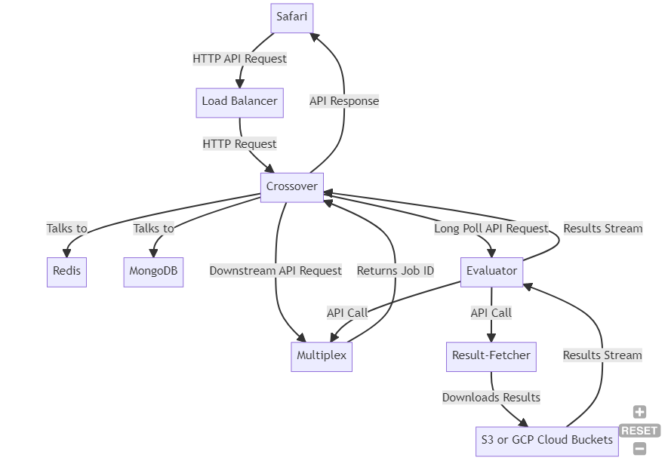
VPC for Network Traffic

Slide 19
AWS Lambda and Serverless Computing

Slide 20
Hybrid Cloud Solutions with AWS

Slide 21
Cloud Migration Strategies to AWS

Slide 22
Disaster Recovery and Backup in AWS

Slide 23
Case Studies: Real-world Applications on AWS

Slide 24
Future Trends and Innovations in AWS

Slide 25
Conclusion and Key Takeaways

